Slide 1
Laser Material Processing(LMP)
Lecture 9 Laser Drilling

Slide 2
Laser Hole Drilling Videos
https://www.youtube.com/watch?v=_HQH0_JP0dw
https://www.youtube.com/watch?v=voNCAzTuS40
https://www.youtube.com/watch?v=wUQhaHVdYxE

Slide 3
Laser Material Processing
- A general classification of the laser material processing techniques is shown in figure
Figure A general classification of the laser material processing

Slide 4
Laser hole drilling
-Laser hole drilling is one-dimension machining processes and it is one of the important and successful application of industrial lasers .
-Laser drilling makes about 3 % of the Laser material processing market. The respective holes have diameters between 0.005 to 1.5 mm and aspect ratios (depth/diameter) from less than 1 to above 50.
-The importance of Laser drilling in industry comes from high processing speeds, exact tolerances, small dimensions and material flexibility.
-In laser drilling processes the laser beam is stationary relative to the work piece.

Slide 5
Laser hole drilling
-Laser drilling uses its high power density to melt or vaporize material from the work piece.
-Holes can be made in materials such as metals, alloys, ceramics and composites.
-The hole diameters and shapes can be changed by controlling on the process variables without change the tools in the drilling process.
-Laser drilling can be done in both pulse and continuous wave modes.

Slide 6
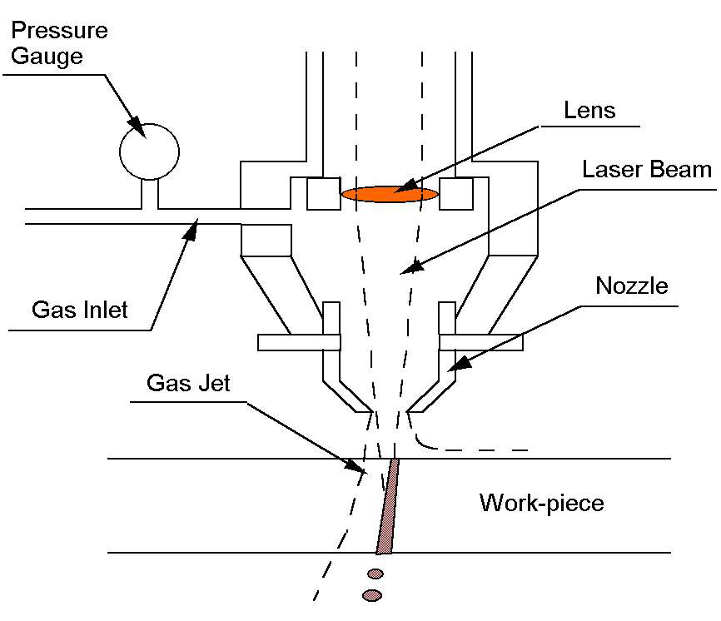
Laser Hole Drilling System

Slide 7
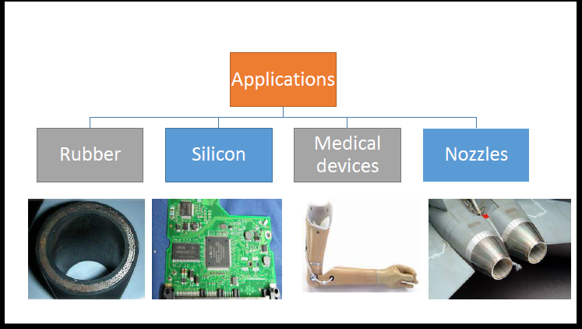
Laser Hole Drilling Applications

Slide 8
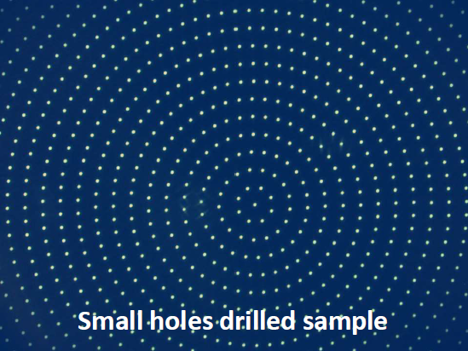

Laser Hole Drilling Applications

Slide 9
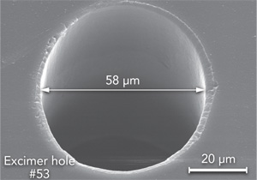
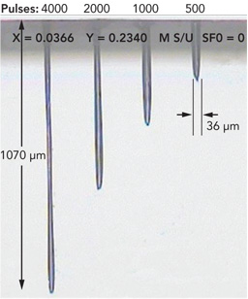
Laser Hole Drilling Applications
FIGURE . 58 µm hole in PET; excimer laser at 248 nm
FIGURE .Holes in fused silica; 193 nm excimer laser; special deep-drilling optics

Slide 10
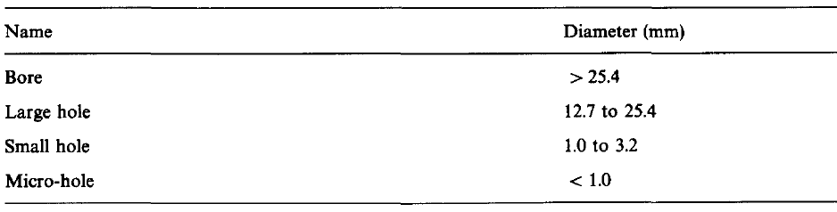
Laser hole drilling
-Definition of a hole
-The general definition of a hole as related to laser drilling being summarized as in table below

Slide 11
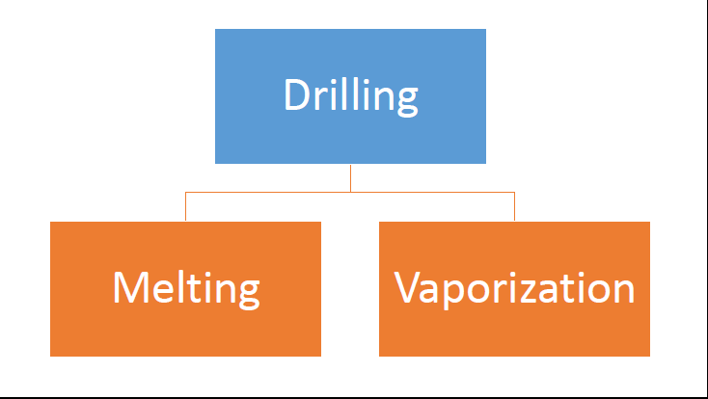
Laser Hole Drilling Mechanism
-Melt ejection and material vaporization are two main mechanisms responsible for material removal in laser drilling

Slide 12
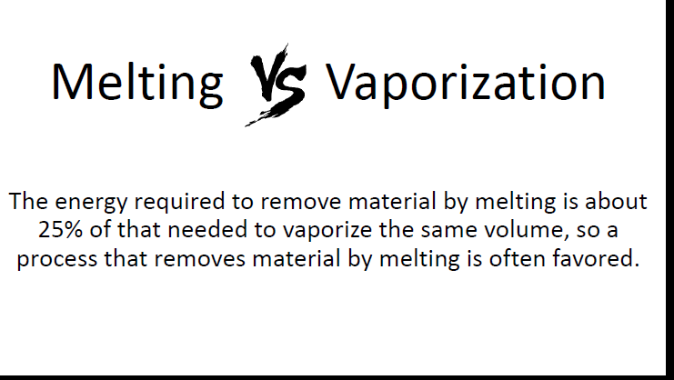
Laser Hole Drilling Mechanism

Slide 13
Laser Hole Drilling Mechanism
-Laser drilling can be performed through:
-Continuous drilling, with the use of a continuous-wave beam, or
-Percussion drilling, with the use of a pulsed beam.
-Control of the drilling process for a given work piece materials is accomplished through selection of:
-Beam power,
-Drilling time, and.
-Focal spot size

Slide 14
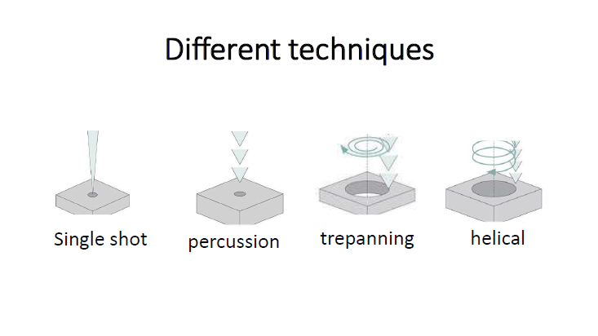
Laser Drilling Techniques

Slide 15
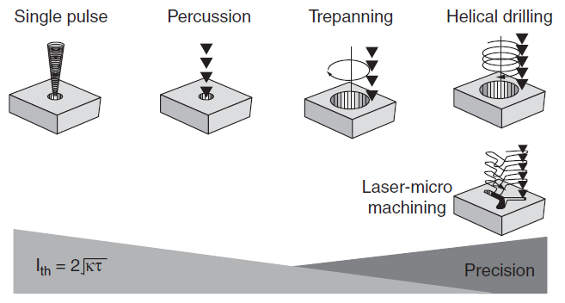
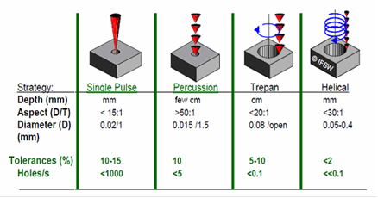
Laser Drilling Techniques
-There are four ways in which a hole can be produced by laser drilling: 1-Single-pulse drilling, 2-Multipulse percussion drilling, 3-Trepanning and 4-Helical drilling.

Slide 16
Laser Drilling Techniques
-Single-Pulse Drilling
-When the target is thin a single pulse can drill through the material. This is the case for thin film drilling, thin foil drilling, or thin plate hole drilling
-The hole diameter produce by this technique can be larger or smaller than the beam diameter and depends on the intensity distribution in the focused laser beam and on the material thickness.
-The pulse duration in this technique of about 1 ms, and energy of several Joules, resulting in a peak power of the order of 10–100 KW

Slide 17
Laser Drilling Techniques
-Multiples Percussion Drilling
-In this technique several laser pulses are used to create the hole as in figure .
-This technique achieves a larger hole diameter to hole depth ratio (up to 1:100 for through holes and 1:20 for blind holes).
-The series of pulses used reduces the production rate. Typical pulse duration ranges from about
10⁻¹³ to 10 ⁻³ S
-Percussion drilling is commonly used in cooling hole drilling of aircraft engines.
-Using single pulse drilling or percussion drilling, thousands of small holes can be drilled in a short period compared to mechanical drilling and EDM drilling

Slide 18
Laser Drilling Techniques
-Trepanning Drilling
-Trepanning involves cutting out the hole by performing a relative motion (circular or noncircular) between the laser beam and the work piece (cutting around edge of the hole) as in figure
-Low energy (compared to single shot pulses),
deeper holes, more precise holes
-This technique can drill holes only with a diameter larger than the laser beam diameter with improved hole quality and repeatability.
- The process is time consuming, typically requiring about 1 s for producing a hole. Holes drilled by this method are often limited to depths less than 12 mm

Slide 19
Laser Drilling Techniques
-Helical drilling,
-In this method the laser beam performs a circular movement with a defined diameter on the surface of the work piece as in figure
-As material is removed by each pulse, the beam works its way through the material on a helical path. In this technique, the beam is rotated in itself.

Slide 20
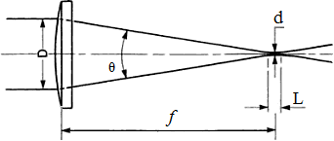
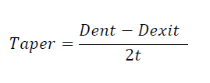
Hole Characteristics of Laser Drilling
-1.Taper of the laser drilled hole is the difference between the two diameters of the samples, diameter at entry (Dent) and diameter at exit (Dexit) as observed in Fig. below and calculated by the following equation:
-Due to convergence nature of the
focused laser beam we have two
different diameters for the drilled
hole on the target.
t is the thickness of the target.
Focusing lens
Laser beam dia.
Focused beam
Target

Slide 21
Hole Characteristics of Laser Drilling
-2.Circularity of the laser drilled hole (CIR) is expressed as the ratio of minimum diameter (D1) to maximum diameter (D2) as shown in Fig. below:
-The circularity of the hole is expressed in equation below
in which means when CIR value is equal to 1, then it indicates that the hole has a perfect circle.

Slide 22

Hole Characteristics of Laser Drilling
-3.Aspect ratio of the drilled hole is calculated by equation:
-Where, Hd is the depth of the drilled hole which equals to sample thickness(t), when the drilled holes is open.

Slide 23
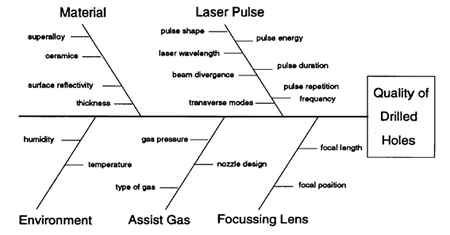
Parameters Affecting On Hole Quality
To obtain a hole of good quality, the optimum principal laser-process parameters must be selected Fig. below

Slide 24
Home Work
In Laser Hole Drilling Mechanism the following is phenomena is observed explain scientifically the reason for that???

